Slide 1
Recycling and Waste Update

Slide 2
Recycling and Waste
Where are we?
How do we compare?
Projects- what have we been doing?
Future plans- where are we going?
Questions

Slide 3

Where we are – compared to last year
51.6% current recycling rate
4% Increase in food recycling currently
3% increase in recycling collected in blue bins
19% general waste collected in green bins

Slide 4
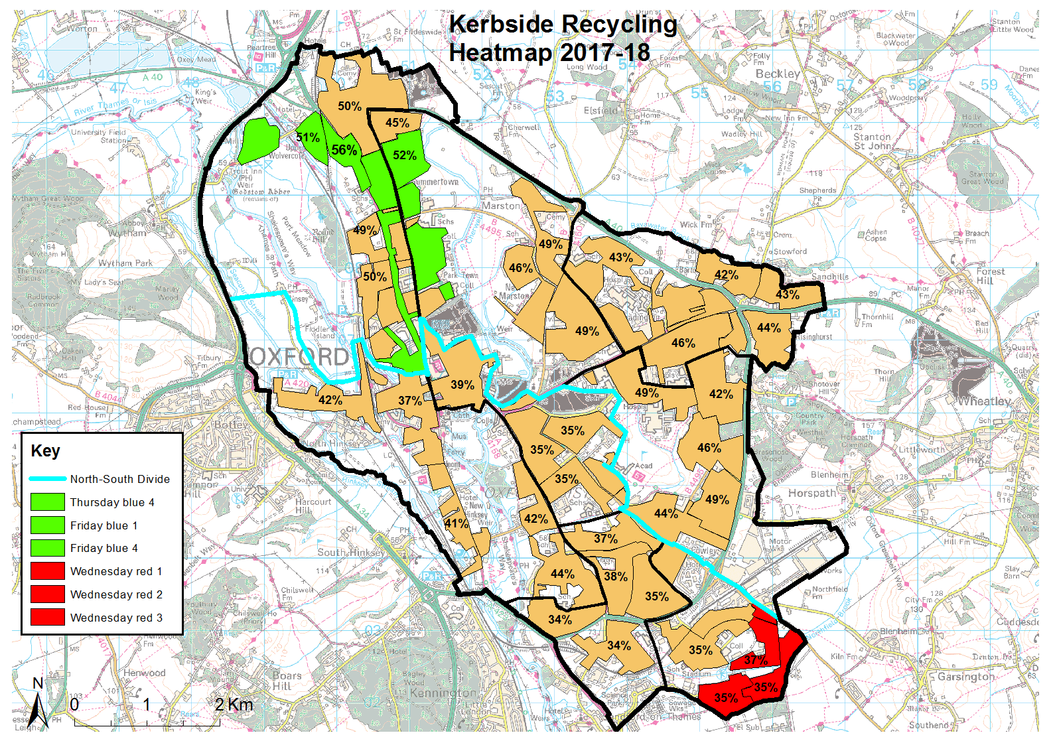

Slide 5
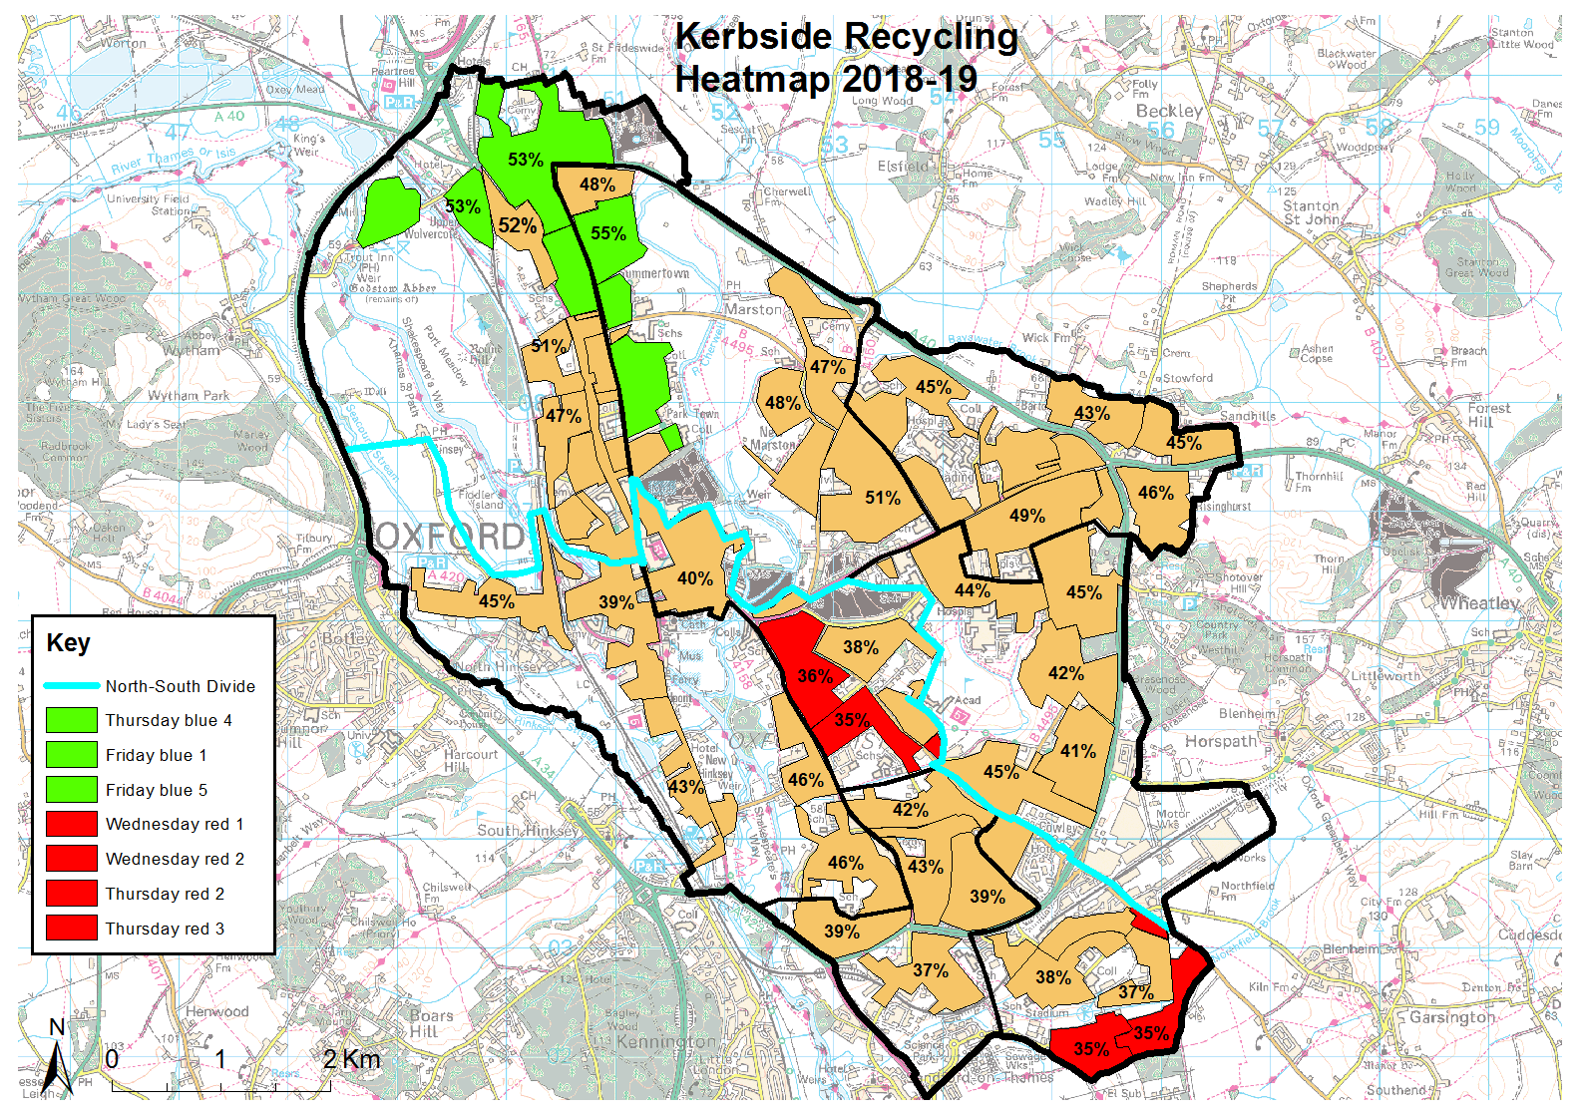

Slide 6
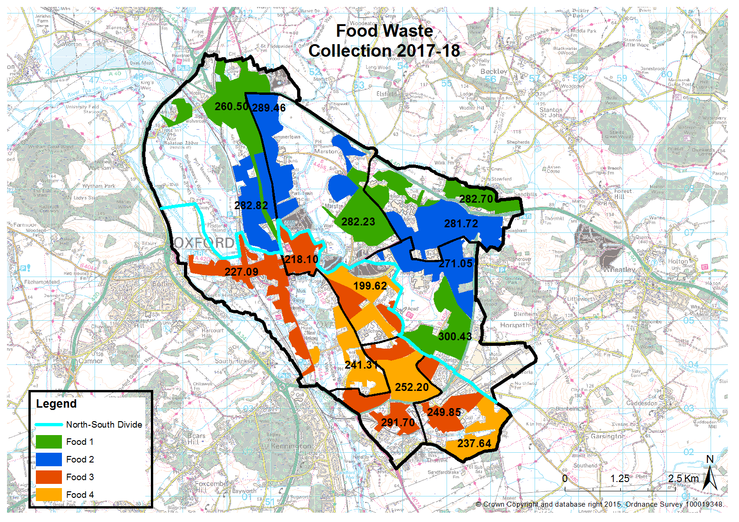

Slide 7
How we compare - Waste Data Flow
Welcome to Oxford Direct Services Presentation Document
Notes:
Colchester made radical changes to their collections and restricted residual waste collections from households:
They now only collect three residual black bags from each household per fortnight.
They have seen a 12% increase in recycling rates and huge increase to Commingled/food.
It made it a top performer nationwide and the second best improver in the country

Slide 8
How we compare - Waste Data Flow
Welcome to Oxford Direct Services Presentation Document
Notes:
Colchester made radical changes to their collections and restricted residual waste collections from households:
They now only collect three residual black bags from each household per fortnight.
They have seen a 12% increase in recycling rates and huge increase to Commingled/food.
It made it a top performer nationwide and the second best improver in the country

Slide 9
How we compare - Waste Data Flow
Welcome to Oxford Direct Services Presentation Document

Slide 10
How we compare – ONS nearest neighbours
Welcome to Oxford Direct Services Presentation Document

Slide 11
How we compare – ONS nearest neighbours
Welcome to Oxford Direct Services Presentation Document
Notes:
OCC is also:
Top performer when compared through the CIPFA (Chartered institute of Public Finanace and Accountancy) model. In front of 6 other local authorities, performing better in N191 and N192
Rented/shared houses are a proven barrier to recycling. Oxford City is bucking the trend by having the highest proportion of rented accomodation in the country yet still being a top recycling perfomer. It’s top of the list compared to authorities with similar proportions of rented housing. By over 10%.

Slide 12
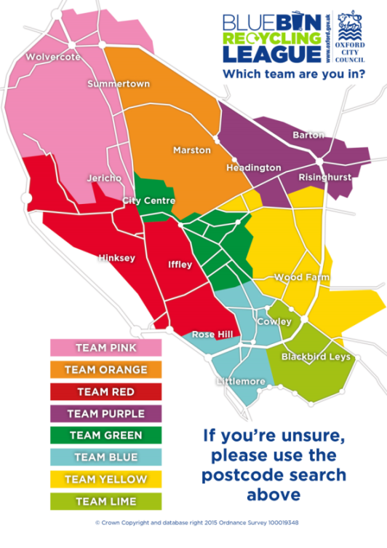
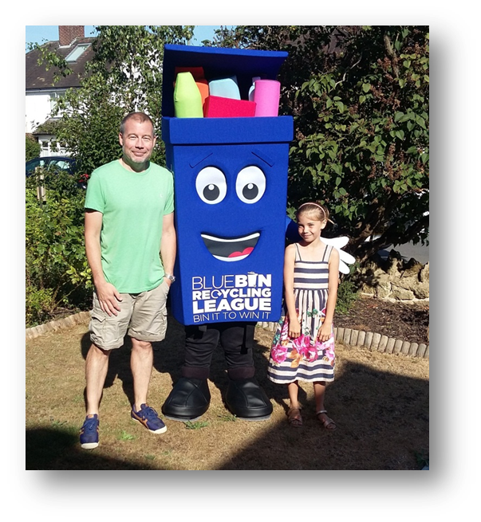
Blue Bin Recycling League - Background
Welcome to Oxford Direct Services Presentation Document
Implemented Oct 2015
Three year DCLG-funded recycling incentive scheme with a £350,000 grant. Now council funded for a further 3 year
Looks at recycling well and wasting less using dry recycling rate improvements per collection zone: current month vs same month previous year
Increased prizes: two monthly resident prizes worth up to £100 and a quarterly community prize of £1,000
Heavy focus on recycling education

Slide 13
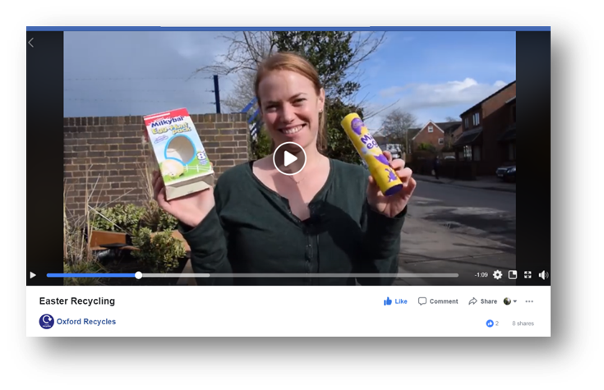
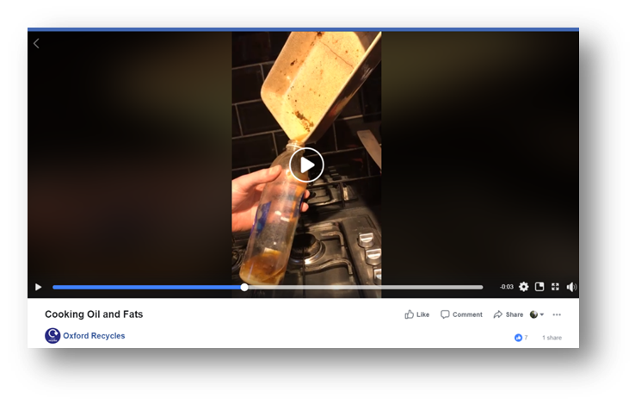
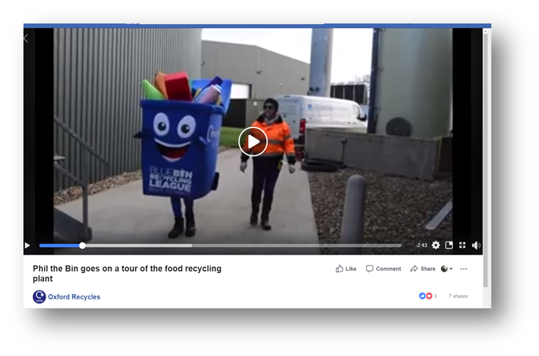
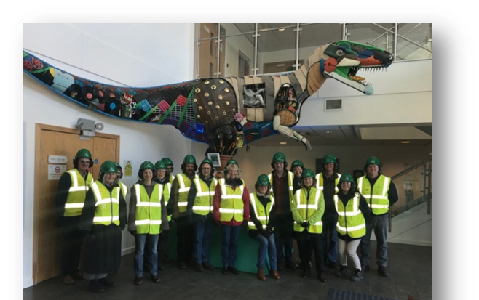
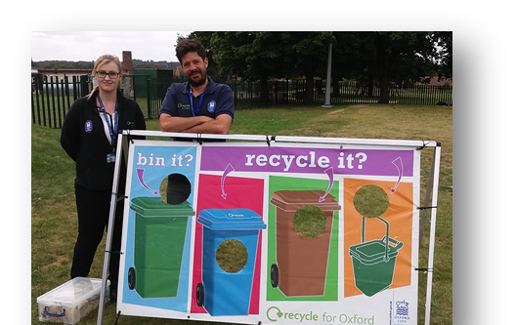
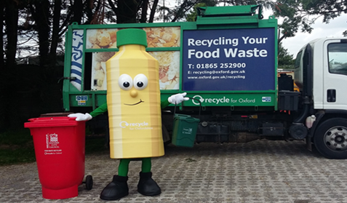
What we do
Welcome to Oxford Direct Services Presentation Document
Door knocking focused on lower performing areas that month based on in-house round information - 58% pledge rate
Social media using normative messaging and innovative resident engagement techniques
Videos made in-house to promote recycling and reuse – stop motion, mascots on tour, boomerangs, seasonal recycling and charity winners (see example)
Recycling mascots
Primary and secondary school engagement – games and activities
Plant tours

Slide 14
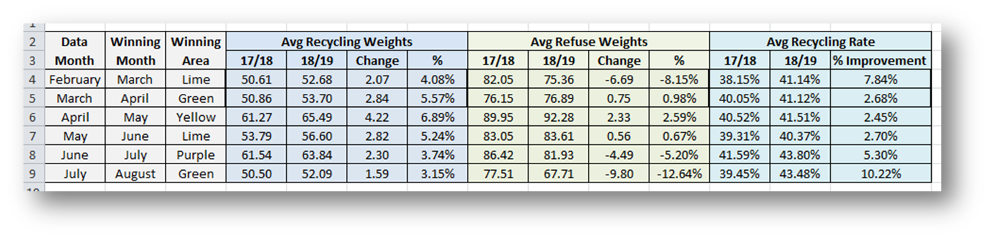
Results
Welcome to Oxford Direct Services Presentation Document
Dry recycling rate improvements of winning teams during the last 6 months
Clear targeted door knocking improvements – e.g. The Leys (Team Lime). Improvement in rates found when focused work in that area

Slide 15
Results

Slide 16
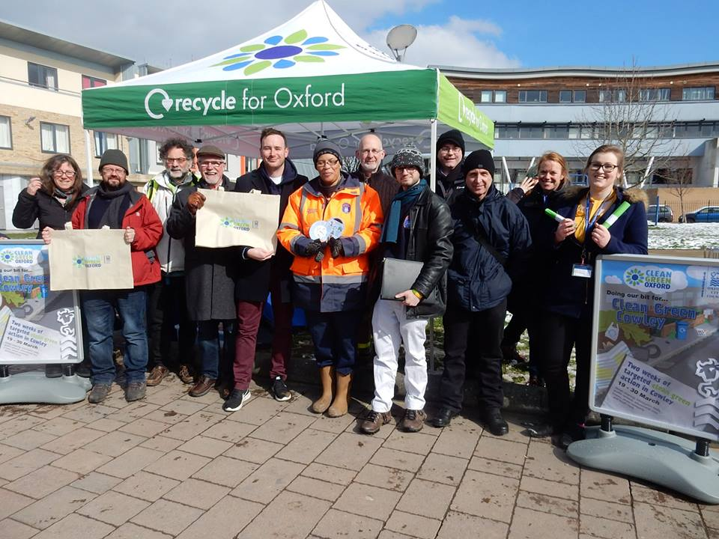
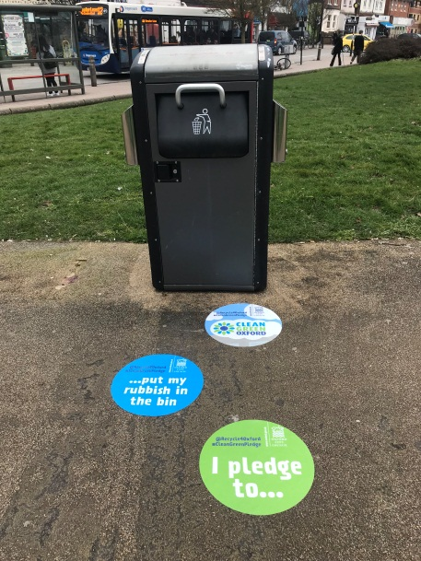
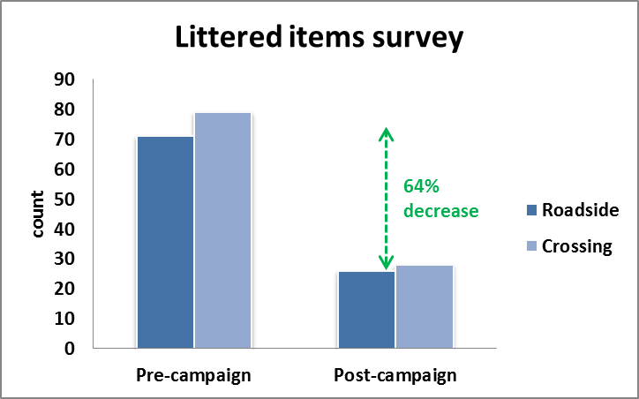
Current campaigns and projects
Clean Green
Welcome to Oxford Direct Services Presentation Document
Cross-organisation working
Holistic approach
Prevention
Education
Engagement
Enforcement
Innovative approach
Floor decals
Litter surveys
Ave 64% reduction in litter
55% resident positive perception

Slide 17
Future plans
Recycling and waste strategy
Student projects
Clean green campaigns
Food recycling collection
Reducing residual waste ??

Slide 18
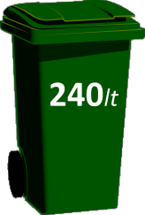
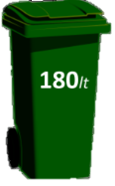
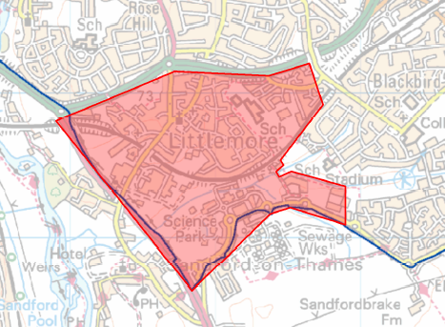
Trial project proposal – Littlemore
Littlemore
The proposal:
Reducing the size of green bins from
Partnership work with all stakeholders
Larger bins will be available for larger households
Offering recycling bins and food waste bins free of charge
Targeted communications campaign
Proven success found through extensive benchmarking- 20 other local authorities.
Findings will inform whether it is a suitable city-wide initiative
What we expect:
Up to 12% increase in recycling rate
Up to 10% decrease in residual waste per
household
Up to 20% increase in food recycling
Participation

Slide 19

Any Questions?
Welcome to Oxford Direct Services Presentation Document
Notes:
Thanks for listening

